Slide 1
Fuzzy logic & approximate reasoning

Slide 2
Introduction:
Classical logic

Slide 3
Proposition logic
As in our ordinary informal language, “sentence”
is used in the logic. Especially, a sentence having only “true (1)” or “false (0)” as its truth value is called “proposition”.
Example:
Proposition:
  It rains now. (true)
  2 + 4 = 7 (false)
  For every x, if f(x) = sin x, then f′(x) = cos x. (true)
Example:
The following are NOT propositions:
  Why are you interested in the fuzzy theory?
  x + 5 = 0

Slide 4
Proposition logic (cont’d)
Definition:
  If we represent a proposition as a variable, the variable can have the value true or false.
  This type of variable is called as a “proposition variable” or “logic variable”

Slide 5




Proposition logic (cont’d)
Connectives - combine prepositional variables
  Negation
  Conjunction
  Disjunction
  Implication
  …
A | B | Λ | V | xV | ⇒ | ⇔ | ?
1 | 1 | 1 | 1 | 0 | 1 | 1 | 1
1 | 0 | 0 | 1 | 1 | 0 | 0 | 1
0 | 1 | 0 | 1 | 1 | 1 | 0 | 0
0 | 0 | 0 | 0 | 0 | 1 | 1 | 0

Slide 6


Proposition logic (cont’d)
Logic function
  a combination of propositional variables by using connectives
Logic formula
  Truth values 0 and 1 are logic formulas
  If is a logic variable, and are a logic formulas
  If a and b represent a logic formula,
  a ∧ b and a ∨ b are also logic formulas

Slide 7






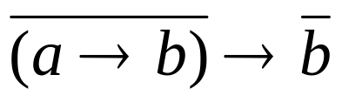
Proposition logic (cont’d)
Definition
  A “tautology” (اصل موضوعه)is a logic formula whose value is always true regardless of its logic variables.
  A “contradiction” (تناقض)is one which is always false.
Example:
1
1
1
0
0
1
1
0
0
1
1
1
0
1
1
0
0
1
0
0
1
0
1
1

Slide 8
Proposition logic (cont’d)
The tautology is used as a rule of deductive inference. There are some important inference rules using tautologies:
Modus ponens (وضع مقدم) : (A ∧ (A→ B)) → B
Modus tollens ( رفع تالي) : ((A→B) ∧ ¬ B)→ ¬A
Syllogism ( قياس منطقي) : ((A→B) ∧ (B→C))→ (A→C)
Contraposition (عكس نقيض) : (A→B) → (¬ B→ ¬ A)

Slide 9
Predicate logic
Definition:
“”Predicate logic” is a logic which represents a proposition with the predicate and individual (objects)
Example:
object
predicate
“Einstein is a man”
”Two is less than five”

Slide 10
Predicate logic (cont’d)
Universal quantifier (kind of an iterated conjunction, when there are only finitely-many individuals)
  “for all”
  denoted symbolically by ∀
Existential quantifier (kind of an iterated disjunction, when there are only finitely-many individuals)
  “there exists”
  denoted symbolically by ∃

Slide 11
Fuzzy logic

Slide 12
Fuzzy logic
Fuzzy expression (formula):
  can have its truth value in the interval [0,1]
    f : [0,1] → [0,1]
  Generalization
    f : [0,1]^{n} → [0,1]

Slide 13
Fuzzy logic (cont’d)
Definition (Fuzzy logic)
  a logic represented by the fuzzy expression (formula) which satisfies the followings
    Truth values, 0 and 1, and variable xi (∈[0,1], i = 1, 2, …, n) are fuzzy expressions
    If f is a fuzzy expression, ~f is also a fuzzy expression
    If f and g are fuzzy expressions, f ∧ g and f ∨ g are also fuzzy expressions

Slide 14
Fuzzy logic (cont’d)
Operators in fuzzy expression
  Negation = 1 – a
  Conjunction a ∧ b = Min (a, b)
  Disjunction a ∨ b = Max (a, b)
  Implication a → b = Min (1, 1+b−a)

Slide 15
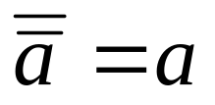
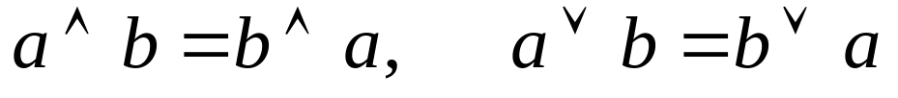
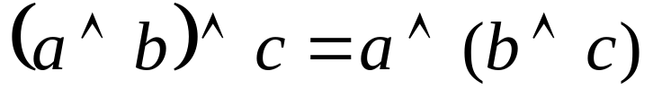
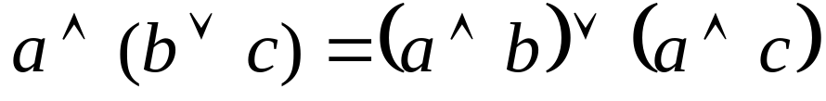

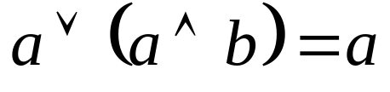
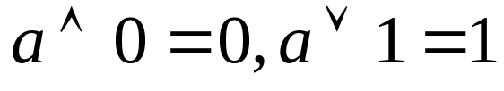
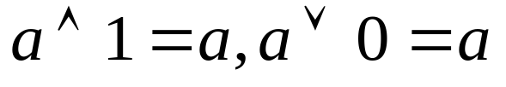
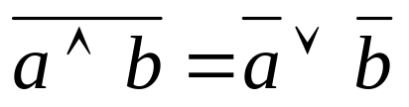
Fuzzy logic (cont’d)
The properties of fuzzy operators
  Involution
  Commutativity
  Associativity
  Distributivity
  Idempotency
  Absorption
  Absorption
  Identity
  De Morgan’s law

Slide 16
Fuzzy logic (cont’d)
Operators in fuzzy expression:
“law of contradiction” and “law of excluded middle” are not verified in the fuzzy logic
  Law of contradiction
    a ∧ ā =Min[a, ā]=Min[a, 1− a]≠0 if a ≠0,1
  Law of excluded middle
    a ∨ ā=Max[a, ā]=Max[a, 1− a]≠1 if a ≠0,1

Slide 17
Linguistic variables

Slide 18
Linguistic variable
Definition:
Linguistic variable (which was called a variable of higher order [Lotfi zadeh 1973])
is a quintuple (x, T(x), U, G, M~) with
  x: name of variable
  T(x): set of linguistic terms which can be a value of the variable
  U: set of universe of discourse which defines the characteristics of the variable
  G: syntactic grammar which produces terms in T(x)
  M~: semantic rules which map terms in T(x) to fuzzy sets in U

Slide 19
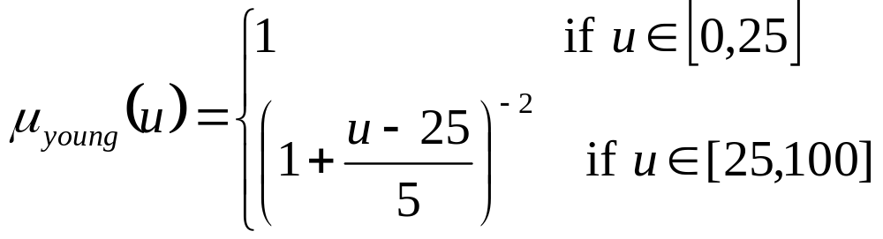
Linguistic variable (cont’d)
Example:
X = (Age, T(Age), U, G, M~)
    Age: name of the variable X
    T(Age): {young, very young, very very young, …}
    U: [0,100] universe of discourse
    G(Age): T^{i+1} = {young} ∪ {very T^{i}}
    M~(young) = {(u, μ_{young}(u)) | u ∈ [0,100]}

Slide 20
Linguistic variable (cont’d)
linguistic variable
AGE
values of Age
very young
young
old
very old
1
0.8
0.6
0.6
0.8
0.9
1
0.7
0.8
0.9
1
1
0.9
0.8
0.6
age
[years]
20
25
30
35
40
45
50
55
60
65
70
75
80
base variable

Slide 21
Linguistic variable (cont’d)
Definition: Fuzzy predicate
  If the set defining the predicates of individual is a fuzzy set, the predicate is called a fuzzy predicate
Example:
“z is expensive” “w is young”
  The terms “expensive” and “young” are fuzzy terms. therefore the sets “expensive(z)” and “young(w)” are fuzzy sets

Slide 22
Linguistic variable (cont’d)
When a fuzzy predicate “x is P” is given, we can interpret it in two ways:
  -P(x) is a fuzzy set. The membership degree of x in the set P is defined by the membership function μ_{P(x)}
  - μ_{P(x)} is the satisfactory degree of x for the property P. Therefore, the truth value of the fuzzy predicate is defined by the membership function
    (Truth value = μ_{P(x)} )

Slide 23
Linguistic variable (cont’d)
Definition:
A linguistic variable x is called structured if the term set T(x) and the meaning M(x) can be characterized algorithmically
Definition:
The linguistic terms often consist of two parts:
predicate(primary term): expensive, old, rare, …
Hedge or modifier: very, likely, almost impossible,…
The modifier is used to change the meaning of predicate and it can be grouped into the following two classes:
-truth qualifier or truth value: quite true, very true, …
-quantifier: many, few, almost, all, usually, …

Slide 24
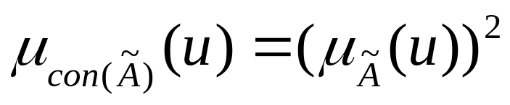
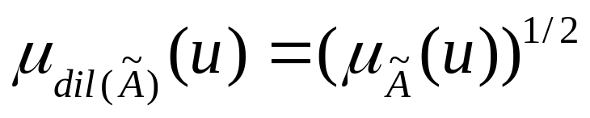
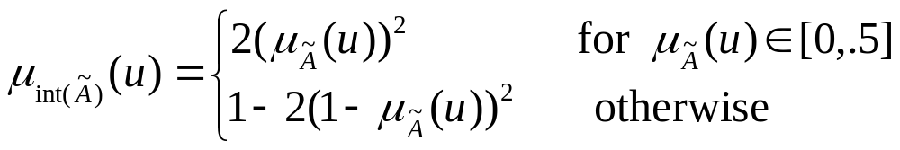
Linguistic variable (cont’d)
Most common mathematical models for modifiers:
Concentration
Dilation
Contrast intensification

Slide 25
Linguistic variable (cont’d)
Example:
A new term can be obtained when we add a modifier “very” to a primary term
  μ_{very young}(u) =concentration (μ_{young} (u))=(μ_{young}(u))²
μ
1
young
0.5
very young
0
u
25
50
75
100
base variable

Slide 26
Linguistic variable (cont’d)
Definition:
A Boolean linguistic variable has terms which are Boolean expressions in variables X_{p} and m(X_{p})
Example:
T(Age)= {young, not young, old, not old,
very young, not young and not old,
young or old, …}
The meaning of different terms can be derived as:
M~(not young)= ¬ young
M~(not very young)= ¬ (young)²
M~(young or old)= young U old

Slide 27
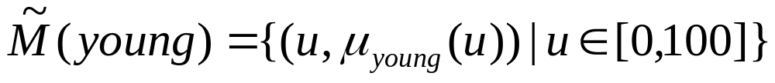
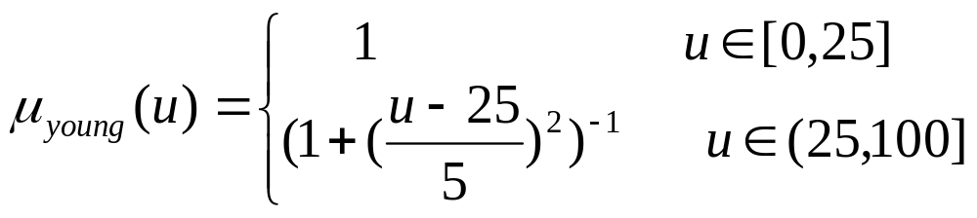
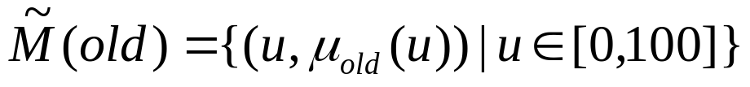
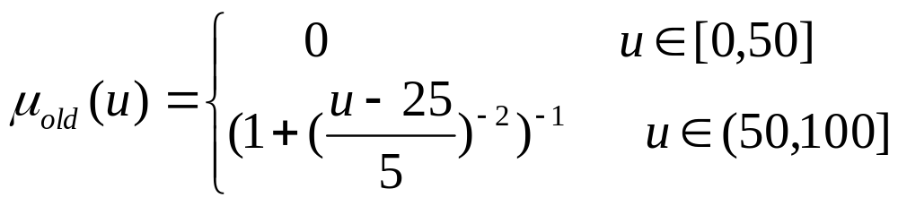
Linguistic variable (cont’d)
Given two fuzzy sets (primary terms) for old and young:
Then, we can compute the MBF of any modified term (young or old, …)

Slide 28
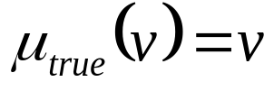
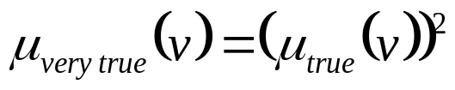
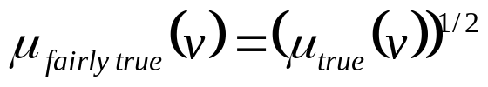

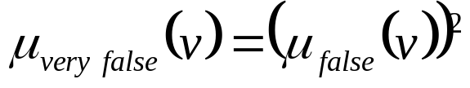
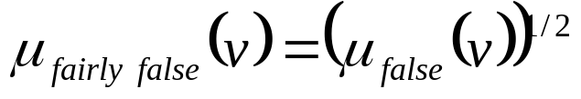
Linguistic variable (cont’d)
TRUTH
Baldwin defined fuzzy modifier terms in the universal set V = {ν | ν ∈ [0,1]} as follows
T = {true, very true, fairly true, absolutely true, … , absolutely false, fairly false, false}
μ
undecided
1
fairly false
fairly true
false
true
very false
very true
Abs. false
Abs. true
ν
0
1

Slide 29
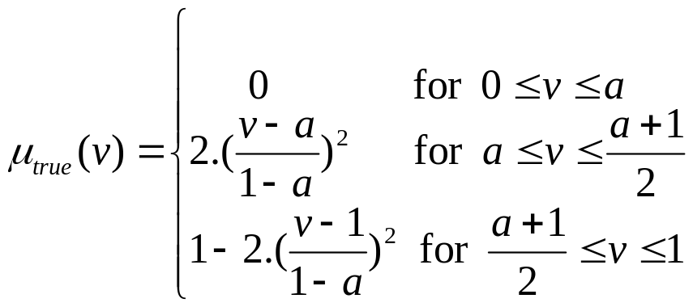
Linguistic variable (cont’d)
TRUTH
Lotfi zadeh had another suggestion for truth MBF:
(a parametric definition with a∈[0,1] )
μ
1
false
true
V=(1-a)/2 is called
the crossover point
μ_{false} (v) = μ_{true}(1-v) 0≤v ≤1
v
(1-a)/2 1-a a (1+a)/2 1

Slide 30
Linguistic variable (cont’d)
Example:
Let’s consider the following predicate:
P=“20 is young”
μ
1
0.9
0.6
young
very young
0
10
20
30
40
50
60
age
The MBF of 20 is young is 0.9

Slide 31
Linguistic variable (cont’d)
Example:
Now, Let’s consider a predicate using the primary term “young” and fuzzy truth qualifier “very false”
Suppose the term “young”
is defined by the function
μ_{young :}
μ
1
0.9
0.6
young
very young
age
0
10
20
30
40
50
Please discuss about the truth value of predicate P as follows:
P = “Ali is young is very false”

Slide 32
Linguistic variable (cont’d)
P₁=“20 is young is true” truth value : 0.9
P₂=“20 is young is fairly true” truth value : 0.95
P₃=“20 is young is very true” truth value : 0.81
P₄=“20 is young is false” truth value : 0.1
μ_{t}(μ_{young})
1
0.95
μ
0.9
fairly true
1
0.81
0.9
false
true
very true
0.6
young
very young
0.1
age
0
μ_{young}(x)
0
10
20
30
40
50
0.9
1

Slide 33
Again back to fuzzy logic
Classical logic:
truth values
  Boolean logic : 1 (true) or 0 (false)
  Multivalued logic, example: true, false, undecided
Vocabulary (operators)
  Each truth table between two statements defines an operator
Reasoning procedure
  Based on tautologies (وضع مقدم, رفع تالي, قياس منطقي, عكس نقيض)
In different logics, there exist different interpretations and implementations for the above items

Slide 34
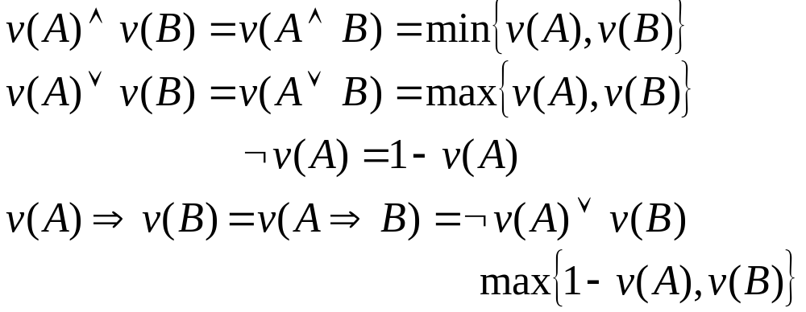
fuzzy logic (cont’d)
The logical operations and, or, not and implied for numerical truth values are defined as:

Slide 35
Linguistic truth tables
In classical two-valued and many-valued logics, operators can be defined by truth tables
In fuzzy logic the number of truth values is infinite
  The tabulation of truth values for the terms of linguistic variables are possible.
Example:
According to Lotfi zadeh (1973) we can extend normal boolean logic to a three-valued logic (true=T, false=F, unknown=T+F), so we have:
∧ | T | F | T+F
T F T+F | T F T+F | F F F | T+F F T +F

Slide 36
Linguistic truth tables (cont’d)
Example:
∨ | T | F | T+F
T F T+F | T T T | T F T+F | T T+ F T +F
 | ¬
T F T+F | F T T+F

Slide 37
Linguistic truth tables (cont’d)
If the number of truth values increase, the resulting variable terms would, possibly, not correspond to any term in the term set for fuzzy variable.
Example:
∨ | T | F | … | More or less true
T F … | T T … | T F … | … … … | …
Not true | … | … | … | Not true ∨ more or less true

Slide 38
Linguistic approximation (cont’d)
In such cases one tries to find the term that is most similar to the resulting fuzzy set
Example:
Let V = {0, 0.1, 0.2, ..., 1} be the universe,
true = {(0.8, 0.9), (0.9, 1), (1, 1)},
more or less true={(0.6,0.2),(0.7,0.4),(0.8,0.7),(0.9,1),(1,1)}
and almost true = {(0.8, 0.9), (0.9, 1), (1, 0.8)}.
“more or less true” ∨ “almost true” =
{(0.6, 0.2), (0.7, 0.4), (0.8, 0.7), (0.9, 1), (1, 1)} ∨
{(0.8, 0.9), (0.9, 1), (1, 0.8)}.
≈ {(0.8, 0.9), (0.9, 1), (1, 1)} = “true”
the term is called linguistic approximation
(like what happens in statistics, empirical functions are often approximated by well-known functions)

Slide 39
Approximate Reasoning
In traditional logic the main tools of reasoning are tautologies :
Modus ponens
  Fact (premise): A is true
  Rule (implication): If A then B
  Result (conclusion): B is true
Modus tollens
  Fact: ¬ B is ture
  Rule: If A then B
  Result: ¬ A is true

Slide 40
Approximate Reasoning (cont’d)
Three possible generalizations of tautologies:
1. To modify the definition of the “implication”
2. To allow statements that are characterized by fuzzy sets.
3. To relax (slightly) the identity of the “A’s” and "B's" in the
premise rule and conclusion (similar instead of identical).
The 2nd choice leads to “approximate reasoning”
And the 2nd a 3rd ones leads to “plausible reasoning”
This version of modus ponens is then called:
"generalized modus ponens”

Slide 41
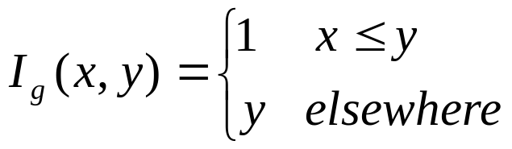
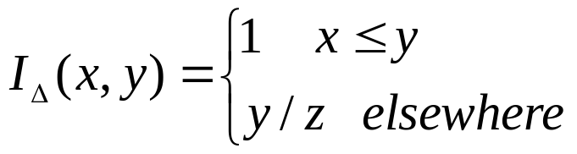
Approximate Reasoning (cont’d)
Generalization by the 1st point
Different implication operators (about 18) have been defined:
Name | Definition of Implication Operator
Early Zadeh Lukasiewicz Minimum (Mamdani) Larsen Standard Star (Godel) Kleene-Dienes Gaines Yager | I_{m}(x,y)=max(1-x,min(x,y)) I_{a}(x,y)=min(1,1-x+y) I_{c}(x,y)=min(x,y) I_{L}(x,y)=prod(x,y) I_{b}(x,y)=max(1-x,y) I_{E}(x,y)=y^{x}

Slide 42
Approximate Reasoning (cont’d)
The quality of these implications can be evaluated empirically or axiomatically.
An axiomatic system for the implication operator being the truth of (A → B) is formulated by Smets and Magrez [1987] by the following:
1. Contrapositive symmetry
2.Exchange principle
3. Monotonically
4. Boundary condition
5. Neutrality principle
6. continuity

Slide 43
Approximate Reasoning (cont’d)
Name | I_{m} | I_{a} | I_{c} | I_{g} | I_{b} | I_{Δ} | I_{B}
A1 Contraposition A2 Exchange Principle A3 Monotonically A4 Boundary Condition A5 Neutrality Principle A6 Continuity | N N N N Y Y | Y Y Y Y Y Y | N Y N N Y Y | N Y Y Y Y N | Y Y Y N Y Y | N N Y Y Y N | N Y Y N Y N

Slide 44
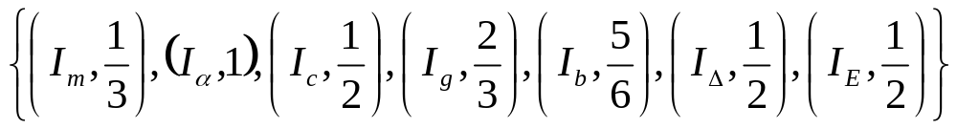
Approximate Reasoning (cont’d)
“Good implication operators” is the following fuzzy set:

Slide 45



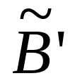
Generalized modus ponens
Generalization by the 3rd point
Premise: x is
Implication: if x is , then y is ‾‾‾‾‾‾‾‾‾‾‾‾‾‾‾‾‾‾‾‾‾‾‾‾‾‾
Conclusion: y is
Example:
Premise: This apple is very red
Implication: If an apple is red then the apple is ripe ‾‾‾‾‾‾‾‾‾‾‾‾‾‾‾‾‾‾‾‾‾‾‾‾‾‾
Conclusion: This apple is very ripe

Slide 46
Generalized modus ponens
Some empirical measures for relating B’ to A’
 | x is A’ | y is B’
measure p1 measure p2 measure p3 measure p4 measure p5 measure p6 measure p7 | x is A x is very A x is very A x is more or less A x is more or less A x is not A x is not A | y is B y is very B y is B y is more or less B y is B y is unknown y is not B
A question is raised: knowing the MBF of “premise”,
How we can infer the MBF of conclusion ?

Slide 47
Compositional Rule of Inference (cont’d)
General form of fuzzy rule
  If A(x), then B(y)
  (If x is A, then y is B)
This rule can be represented by a relation R(x, y)
  R(x, y): A(x) → B(y)
Generalized modus ponens (GMP)
  Fact: x is A′ : R(x)
  Rule: If x is A then y is B : R(x, y)
  Result: y is B′ : R(y) = R(x) ο R(x, y)

Slide 48
Compositional Rule of Inference (cont’d)
.Generalized modus tollens (GMT)
    Fact: y is B′ : R(y)
    Rule: If x is A then y is B : R(x, y)
    Result: x is A′ : R(x) = R(y) ο R(x, y)

Slide 49
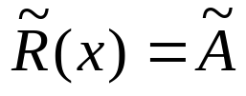

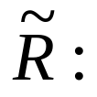
Compositional Rule of Inference (cont’d)
Example:
Let the universe be X = {1, 2, 3, 4}.
A = little = {(1, 1), (2, 0.6), (3, 0.2), (4, 0)}
R = "approximately equal" be a fuzzy relation
defined by
₁ ₂ ₃ ₄
1
2
3
4
1 | .5 | 0 | 0
.5 | 1 | 5 | 0
0 | .5 | 1 | .5
0 | 0 | .5 | 1
Compute the composition of and

Slide 50
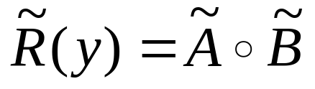
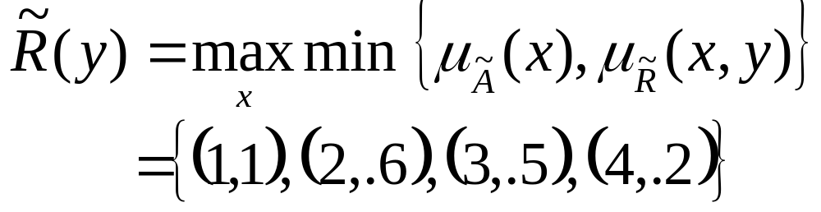
Compositional Rule of Inference (cont’d)
Applying the max-min composition, we obtain:
A possible interpretation of the inference may be:
x is little
x and y are approximately equal
------------------------------------
y is more or less little

Slide 51
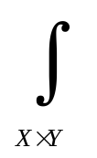
Compositional Rule of Inference (cont’d)
-R~ = A → B
R can be viewed as a fuzzy set with a two-dimensional MBF μ_{R}(x, y) = f(μ_{A}(x), μ_{B}(y))
-Examples of fuzzy implication functions:
-Min operation rule of fuzzy implication (Mamdani)
R_{C} = A × B = μ_{A}(x) ∧ μ_{B}(y) / (x, y)
where ∧ is the min operator
-Product operation rule of fuzzy implication (Larsen)
R_{P} = A × B = μ_{A}(x) • μ_{B}(y) / (x, y)
where • is the algebraic product operator

Slide 52
Compositional Rule of Inference (cont’d)
Example:
consider a fuzzy rule in the following :
“If temperature is high, then humidity is fairly high”
R(t, h): If t is A, then h is B.
R(t, h): R(t) → R(h) R(t): t is A R(h): h is B
t
20
30
40
h
20
50
70
90
μ_{A}(t)
0.1
0.5
0.9
μ_{B}(h)
0.2
0.6
0.7
1
Membership of A in T (temperature)
Membership degrees of B in H (humidity)
we want to get information about the humidity when there is the following premise about the temperature:
“Temperature is fairly high”

Slide 53
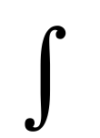
Compositional Rule of Inference (cont’d)
R_{C}(t, h) = A × B
= μ_{A}(t) ∧ μ_{B}(h) / (t, h)
h
20
50
70
90
t
20
0.1
0.1
0.1
0.1
30
0.2
0.5
0.5
0.5
40
0.2
0.6
0.7
0.9

